Slide 1


A primer on (Approximate) Bayesian (Computation)
Oscar Lao

Slide 2
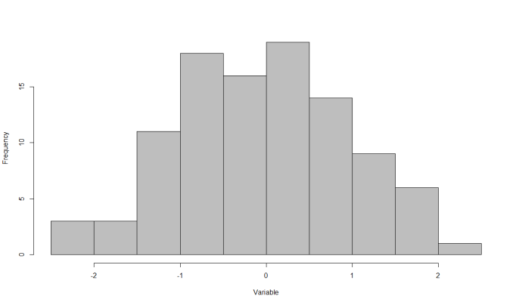
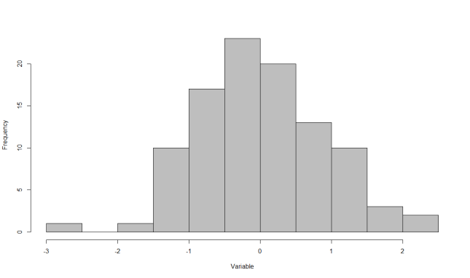
MODEL, PARAMETER(s) AND OBSERVED DATA
MODEL
θ
θ?

Slide 3
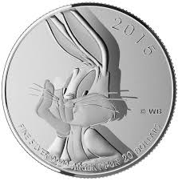
MODEL, PARAMETER(s) AND OBSERVED DATA
9 heads out of 50 trials
θ= fHEAD
θ?

Slide 4
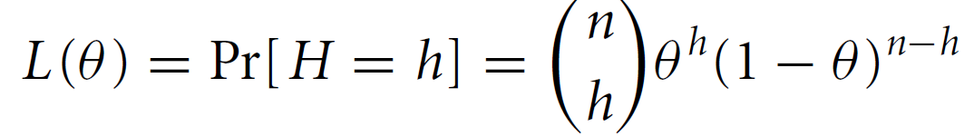
MODEL, PARAMETER(s) AND OBSERVED DATA
9 heads out of 50 trials
θ= fHEAD
θ?

Slide 5
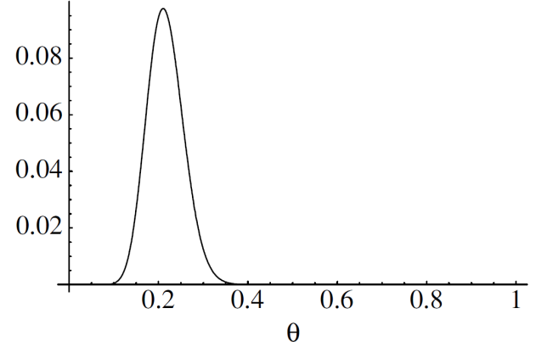
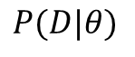
A BAYESIAN VIEW
$$P(D|θ)$$

Slide 6
A BAYESIAN VIEW
$$P(D|θ)$$

Slide 7
A BAYESIAN VIEW
$$P(D|θ)$$

Slide 8
A BAYESIAN VIEW
Key message:
We do not have a single value, but a distribution of values
$$P(D|θ)$$

Slide 9
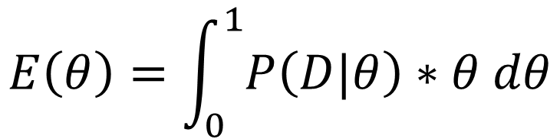
A BAYESIAN VIEW
$$E\left(θ\right)=\int_{0}^{1}{P\left(D|θ\right)∗θ dθ}$$
The area does not add to 1!
$$P(D|θ)$$
What if we knew from previous experiences that some values are more likely than others?

Slide 10
A BAYESIAN VIEW
The area still does not add to 1!
“mixture of distributions”
P(θ)P(D|θ)

Slide 11
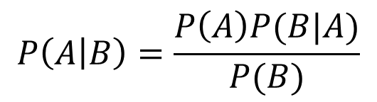
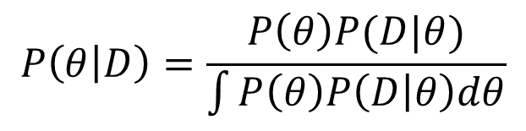
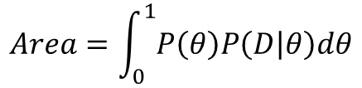
A BAYESIAN VIEW
$$P\left(A | B\right)=\frac{P\left(A\right)P(B|A)}{P(B)}$$
Bayes theorem!
$$Area=\int_{0}^{1}{P\left(θ\right)P\left(D | θ\right)dθ}$$
P(θ)P(D|θ)
$$P\left(θ | D\right)=\frac{P\left(θ\right)P(D|θ)}{\int{P\left(θ\right)P\left(D | θ\right)dθ}}$$

Slide 12
A BAYESIAN VIEW
$$P\left(A | B\right)=\frac{P\left(A\right)P(B|A)}{P(B)}$$
Bayes theorem!
$$Area=\int_{0}^{1}{P\left(θ\right)P\left(D | θ\right)dθ}$$
P(θ)P(D|θ)
$$P\left(θ | D\right)=\frac{P\left(θ\right)P(D|θ)}{\int{P\left(θ\right)P\left(D | θ\right)dθ}}$$

Slide 13
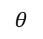

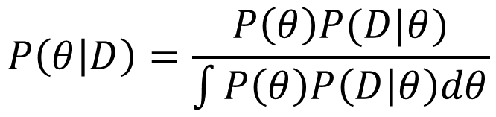
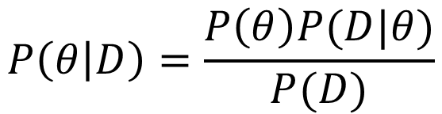
A formal way of expressing it…
A BAYESIAN VIEW
$$P\left(D;θ\right)=P\left(θ\right)P\left(D | θ\right)=P\left(D\right)P\left(θ | D\right)$$
Prior knowledge
$$P\left(θ | D\right)=\frac{P\left(θ\right)P(D|θ)}{P(D)}$$
“our current knowledge is a mixture of what we previously knew updated with new data”
Posterior distribution of
$$θ$$
Normalizing constant (makes it a probability distribution)
$$P\left(D\right)=\int{P\left(θ\right)P\left(D | θ\right)dθ}$$
$$P\left(θ | D\right)=\frac{P\left(θ\right)P(D|θ)}{\int{P\left(θ\right)P\left(D | θ\right)dθ}}$$
“integrating over the marginals”

Slide 14
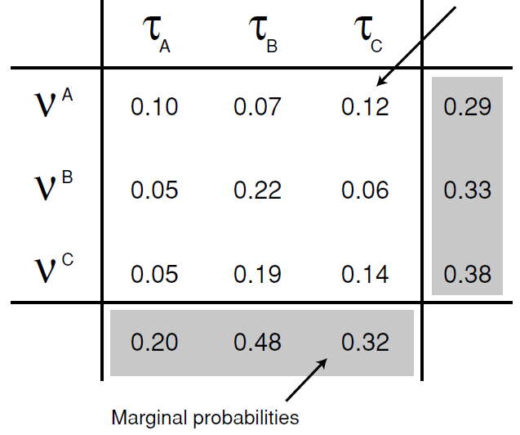
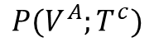
Some extra definitions
A BAYESIAN VIEW
$$P(V^{A};T^{c})$$

Slide 15
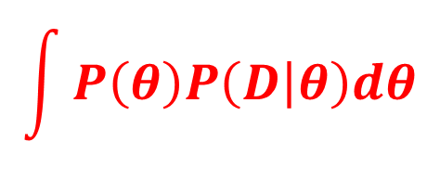
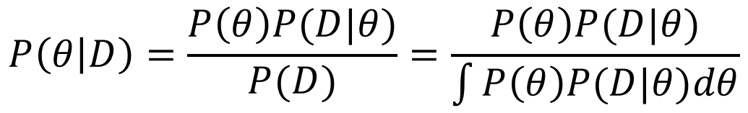
Implementing Bayesian
$$P\left(θ | D\right)=\frac{P\left(θ\right)P(D|θ)}{P(D)}=\frac{P\left(θ\right)P(D|θ)}{\int{P\left(θ\right)P(D|θ)dθ}}$$
$$\int{P\left(θ\right)P\left(D | θ\right)dθ}$$

Slide 16
Implementing Bayesian
$$P\left(θ | D\right)=\frac{P\left(θ\right)P(D|θ)}{P(D)}=\frac{P\left(θ\right)P(D|θ)}{\int{P\left(θ\right)P(D|θ)dθ}}$$
$$\int{P\left(θ\right)P\left(D | θ\right)dθ}$$
What if it does not exist?

Slide 17
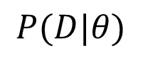
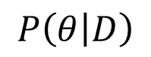
Implementing Bayesian
SOLUTION 1: Find a conjugate
9 heads out of 50 trials
θ= fHEAD
$$P(D|θ)$$
$$P\left(θ | D\right)$$

Slide 18
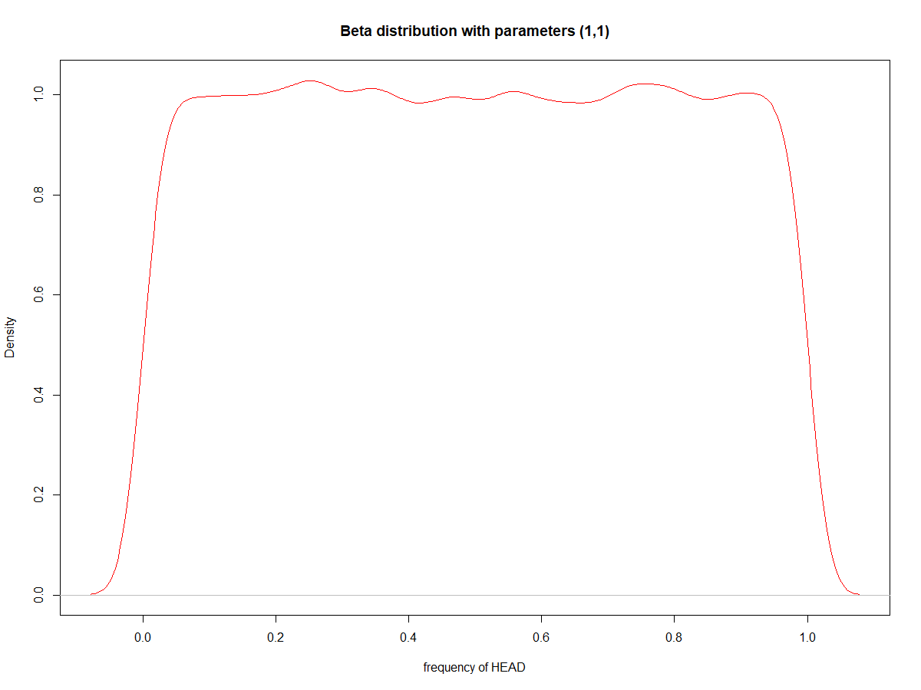
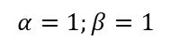
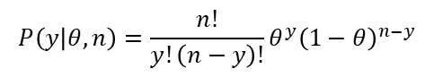
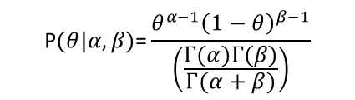
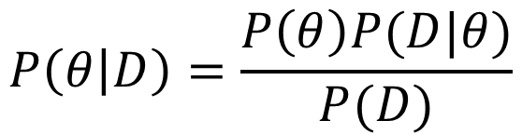
Implementing Bayesian
SOLUTION 1: Find a conjugate
Assume uniform prior knowledge (“the frequency can be any value between 0 and 1 with equal probability”)
$$P\left(θ | D\right)=\frac{P\left(θ\right)P(D|θ)}{P(D)}$$
Binomial Distribution
$$P\left(y | θ,n\right)=\frac{n!}{y!\left(n−y\right)!}θ^{y}{\left(1−θ\right)}^{n−y}$$
Beta distribution
$$\text{P}(θ|α,β)\text{=}\frac{θ^{α−1}{\left(1−θ\right)}^{β−1}}{\left(\frac{Γ(α)Γ(β)}{Γ(α+β)}\right)}$$
$$α=1;β=1$$

Slide 19
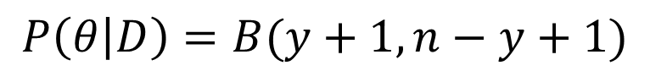
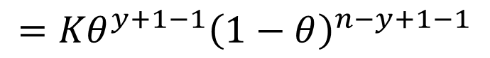
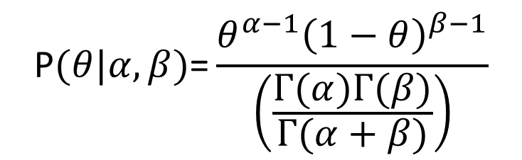
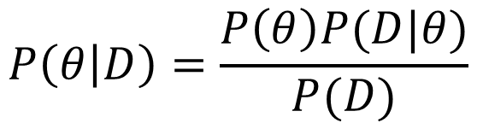
Implementing Bayesian
SOLUTION 1: Find a conjugate
Function kernel
$$P\left(θ | D\right)=\frac{P\left(θ\right)P(D|θ)}{P(D)}$$
$$={Kθ}^{y+1−1}{\left(1−θ\right)}^{n−y+1−1}$$
$$\text{P}(θ|α,β)\text{=}\frac{θ^{α−1}{\left(1−θ\right)}^{β−1}}{\left(\frac{Γ(α)Γ(β)}{Γ(α+β)}\right)}$$
Beta distribution
“Beta distribution is a conjugate of the Binomial distribution”
$$P\left(θ | D\right)=B(y+1,n−y+1)$$

Slide 20

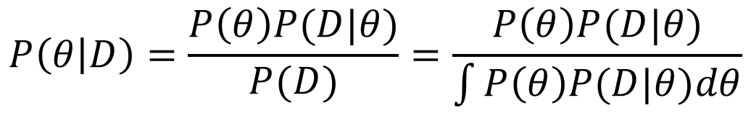
Implementing Bayesian
SOLUTION 2: MCMC
$$P\left(θ | D\right)=\frac{P\left(θ\right)P(D|θ)}{P(D)}=\frac{P\left(θ\right)P(D|θ)}{\int{P\left(θ\right)P(D|θ)dθ}}$$
$$\int{P\left(θ\right)P\left(D | θ\right)dθ}$$
What if there is no conjugate?
What if it does not exist?

Slide 21
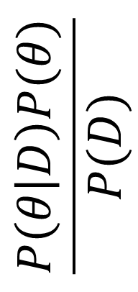

Implementing Bayesian
SOLUTION 2: MCMC
$$\frac{P\left(θ | D\right)P(θ)}{P(D)}$$
$$θ$$

Slide 22
Implementing Bayesian
SOLUTION 2: MCMC
At least, is there any way we can generate samples from this (unknown) posterior distribution so we can broadly regenerate the (unknown) posterior distribution?
$$\frac{P\left(θ | D\right)P(θ)}{P(D)}$$
?
$$θ$$

Slide 23
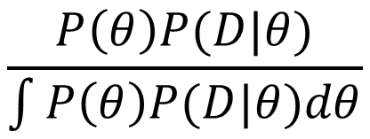
Implementing Bayesian
SOLUTION 2: MCMC
$$\frac{P\left(θ\right)P(D|θ)}{\int{P\left(θ\right)P(D|θ)dθ}}$$
$$\frac{P\left(θ | D\right)P(θ)}{P(D)}$$
?
$$θ$$

Slide 24
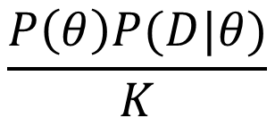
Implementing Bayesian
SOLUTION 2: MCMC
$$\frac{P\left(θ\right)P(D|θ)}{K}$$
$$\frac{P\left(θ | D\right)P(θ)}{P(D)}$$
?
i
j
$$θ$$

Slide 25
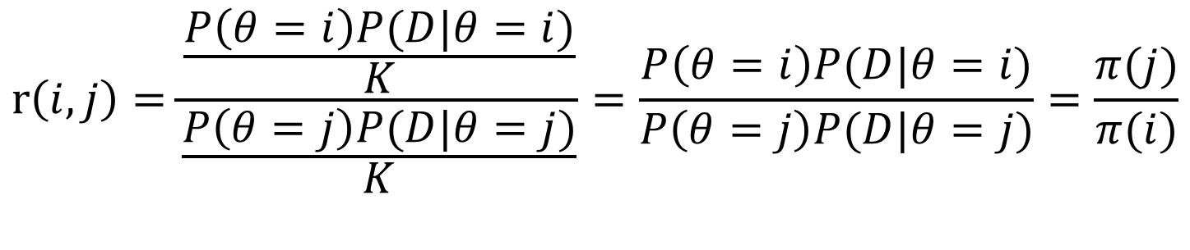
Implementing Bayesian
SOLUTION 2: MCMC
How many times is more likely j than i in this (unknown) distribution?
$$r\left(i,j\right)=\frac{\frac{P\left(θ=i\right)P(D|θ=i)}{K}}{\frac{P\left(θ=j\right)P(D|θ=j)}{K}}=\frac{P\left(θ=i\right)P(D|θ=i)}{P\left(θ=j\right)P(D|θ=j)}=\frac{π(j)}{π(i)}$$

Slide 26
Implementing Bayesian
SOLUTION 2: MCMC
Metropolis algorithm
(there are many others!)
1) Initialize i (pick a value of θ at random)
$$\frac{P\left(θ | D\right)P(θ)}{P(D)}$$
?
i
$$θ$$

Slide 27
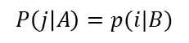
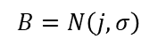
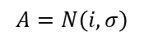
Implementing Bayesian
SOLUTION 2: MCMC
Metropolis algorithm
(there are many others!)
Initialize i (pick a value of θ at random)
Propose a movement q(.|i)
$$\frac{P\left(θ | D\right)P(θ)}{P(D)}$$
P(q(j|i))=P(q(i|j))
$$A=N\left(i,σ\right)$$
?
$$B=N\left(j,σ\right)$$
$$P\left(j | A\right)=p(i|B)$$
i
j
$$θ$$

Slide 28
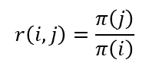
Implementing Bayesian
SOLUTION 2: MCMC
Metropolis algorithm
(there are many others!)
Initialize i (pick a value of θ at random)
Propose a movement q(.|i)
Compute
$$\frac{P\left(θ | D\right)P(θ)}{P(D)}$$
$$r\left(i,j\right)=\frac{π\left(j\right)}{π\left(i\right)}$$
?
i
j
$$θ$$

Slide 29
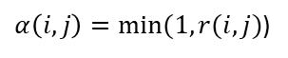
Implementing Bayesian
SOLUTION 2: MCMC
Metropolis algorithm
(there are many others!)
Initialize i (pick a value of θ at random)
Propose a movement q(.|i)
Compute
Move to j in probability
$$\frac{P\left(θ | D\right)P(θ)}{P(D)}$$
$$r\left(i,j\right)=\frac{π\left(j\right)}{π\left(i\right)}$$
?
$α\left(i,j\right)=min⁡(1,r(i,j)$)
“acceptance ratio”
i
j
$$θ$$

Slide 30
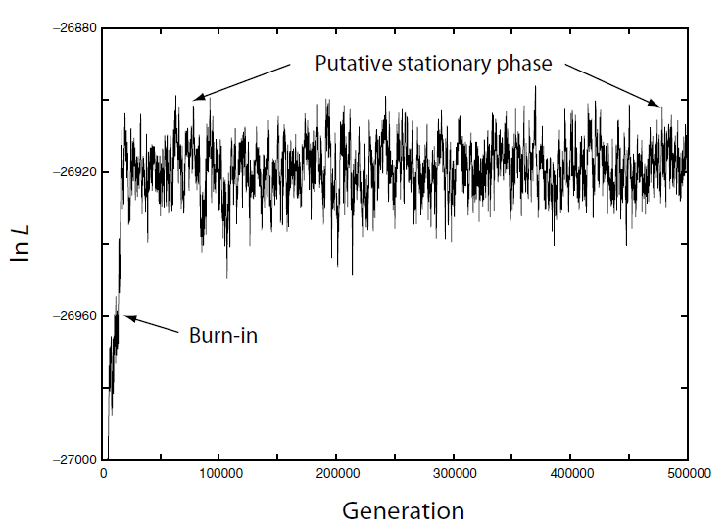
Implementing Bayesian
SOLUTION 2: MCMC
When to stop?
Usually we start out of the most likely values of the posterior

Slide 31
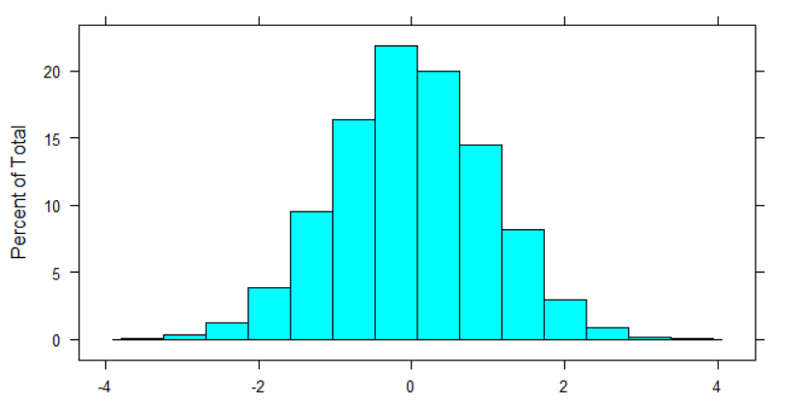
Implementing Bayesian
Centrality statistics
(Mean, Median, Mode…)
Dispersion statistics
(95 Credible Interval
…)

Slide 32
Implementing Bayesian
“Model adequacy is a different concern than model fit:
the latter determines which of a set of models is least bad
(or “best”) for the data, whereas the former determines
whether a single model adequately describes the data.
For example, a model that says humans, chimps, and
mice all diverged simultaneously 70 million years ago is
a better fit to the data than one that puts that divergence
700 million years ago, but neither model adequately
describes the data. Adequacy is often evaluated by
simulating under the focal model to see if it generates
data indistinguishable from the empirical data using one
or more measures.”
Syst. Biol. 62(5):725–737, 2013

Slide 33
Implementing Bayesian
In practice: sample from the posterior distribution, generate datasets, and check out how similar are these simulated datasets to the observed data
“Model adequacy is a different concern than model fit:
the latter determines which of a set of models is least bad
(or “best”) for the data, whereas the former determines
whether a single model adequately describes the data.
For example, a model that says humans, chimps, and
mice all diverged simultaneously 70 million years ago is
a better fit to the data than one that puts that divergence
700 million years ago, but neither model adequately
describes the data. Adequacy is often evaluated by
simulating under the focal model to see if it generates
data indistinguishable from the empirical data using one
or more measures.”
Syst. Biol. 62(5):725–737, 2013

Slide 34
Implementing Bayesian
SOLUTION 3: ABC
$$P\left(θ | D\right)=\frac{P\left(θ\right)P(D|θ)}{P(D)}=\frac{P\left(θ\right)P(D|θ)}{\int{P\left(θ\right)P(D|θ)dθ}}$$
$$\int{P\left(θ\right)P\left(D | θ\right)dθ}$$
What if there is no close form of the likelihood of the data given the parameters?
What if it does not exist?

Slide 35

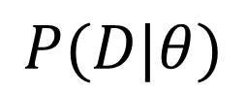
Implementing Bayesian
SOLUTION 3: ABC
$$P(D|θ)$$
We do not know
We can simulate datasets D given
$$θ$$

Slide 36
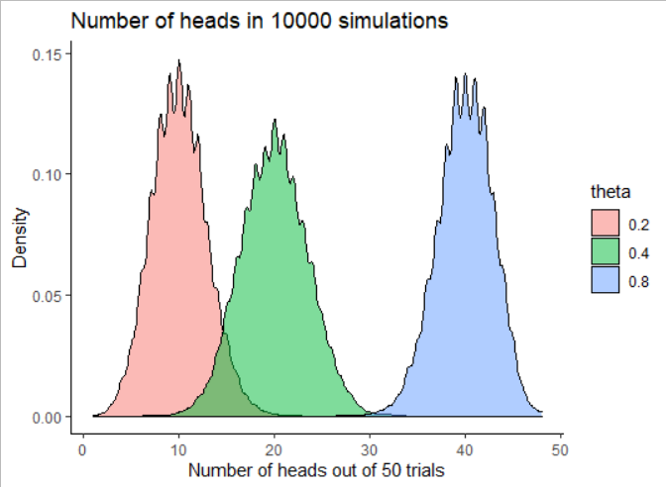

Implementing Bayesian
SOLUTION 3: ABC
θ= fHEAD
$$P(D|θ)$$

Slide 37
Implementing Bayesian
SOLUTION 3: ABC
Observed:
9 trials out of 50

Slide 38
Implementing Bayesian
SOLUTION 3: ABC
The number of times I observe 9 out of 50 is proportional to P(heads = 9|50;theta)
Observed:
9 trials out of 50

Slide 39
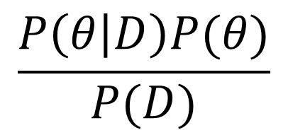
Implementing Bayesian
SOLUTION 3: ABC
“Sampled from”
$$\frac{P\left(θ | D\right)P(θ)}{P(D)}$$
Number of times we get
the observed result

Slide 40

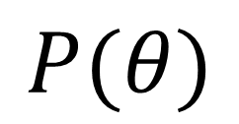
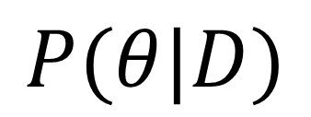
Implementing Bayesian
SOLUTION 3: ABC
$$P(θ)$$
The number of times I observe 9 out of 50 is proportional to P(heads = 9|50;theta)
Pick theta value(s) given its
Generate a simulation with the theta
If the simulation produces the same data as the observed, keep the value of
Repeat n times
The retrained k values are sampled from the posterior distribution of
$$θ$$
$$P(θ|D)$$
Observed:
9 trials out of 50

Slide 41
Implementing Bayesian
Simulate data
Compare with observed data
Retain simulation parameters if they are the same

Slide 42
Implementing Bayesian
SOLUTION 3: ABC Rejection
$$P(θ)$$
The number of times I observe 9 out of 50 is proportional to P(heads = 9|50;theta)
Pick theta value(s) given its
Generate a simulation with the theta
If the simulation produces the same data as the observed, keep the value of
Repeat n times
The retrained k values are sampled from the posterior distribution of
$$θ$$
$$P(θ|D)$$
Observed:
9 trials out of 50

Slide 43
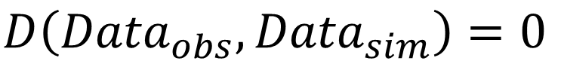
Implementing Bayesian
SOLUTION 3: ABC Rejection
“Same”
$$D\left({Data}_{obs},{Data}_{sim}\right)=0$$
$$P(D\left({Data}_{obs},{Data}_{sim}\right)=0|θ)≈0$$
$$D\left({Data}_{obs},{Data}_{sim}\right)<ε_{threshold }$$
“Pick the closest k simulations to the observed data out of N total simulations”

Slide 44
Implementing Bayesian
Simulate data
Compare with observed data
Retain simulation parameters given ε threshold

Slide 45
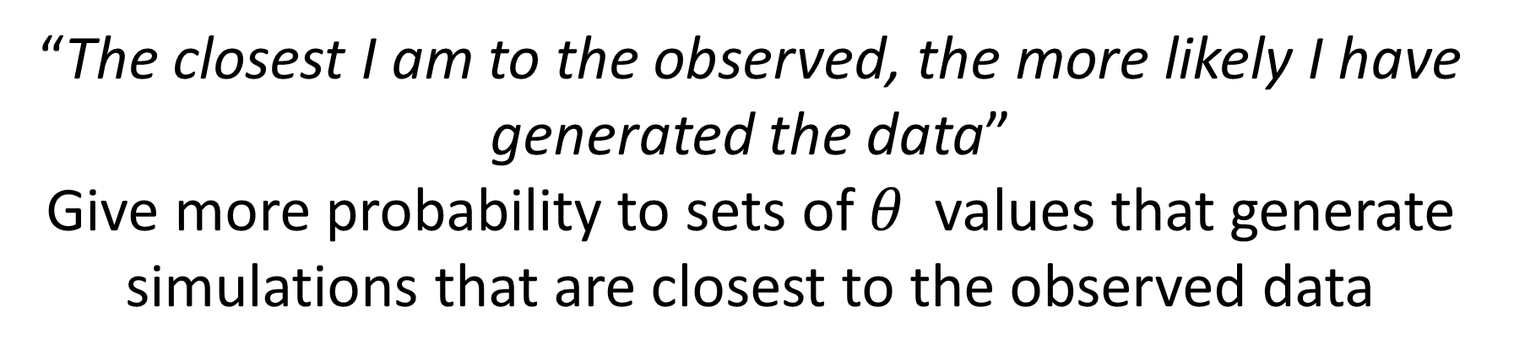
Implementing Bayesian
SOLUTION 3: ABC weighted
“Closest”
$$D\left({Data}_{obs},{Data}_{sim}\right)<ε_{threshold }$$
“The closest I am to the observed, the more likely I have generated the data”
Give more probability to sets of $θ$ values that generate simulations that are closest to the observed data

Slide 46


Implementing Bayesian
SOLUTION 3: ABC weighted
How?
$$D\left({Data}_{obs},{Data}_{sim}\right)$$
$$θ$$

Slide 47
Implementing Bayesian
SOLUTION 3: ABC weighted
How?
Kernel function
$$D\left({Data}_{obs},{Data}_{sim}\right)$$
Weight
$$θ$$

Slide 48
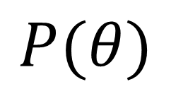
Implementing Bayesian
After weighting, my posterior will include values not present in the prior…
SOLUTION 3: ABC weighted
Undesired effects…
$$P(θ)$$
$$D\left({Data}_{obs},{Data}_{sim}\right)$$
Weight
$$θ$$

Slide 49
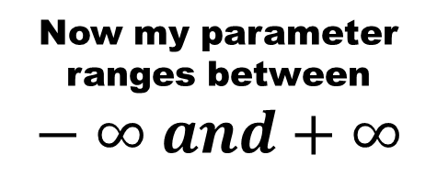
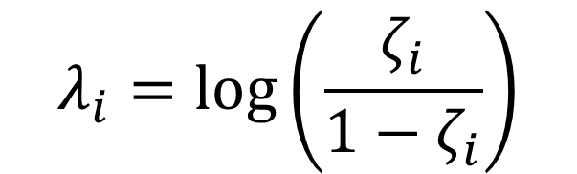

Implementing Bayesian
SOLUTION 3: ABC weighted
Logit transformation
$$ζ_{i}=\frac{θ_{i}−θ_{min}}{θ_{max}−θ_{min}}$$
Now my parameter ranges between 0 and 1
$$λ_{i}=log⁡\left(\frac{ζ_{i}}{1−ζ_{i}}\right)$$
Now my parameter ranges between $−∞ and+∞$
Estimate the posterior using $λ_{i}$ and do back transformation to get $θ_{i}$

Slide 50
Implementing Bayesian
SOLUTION 3: ABC
“Data”
How do you compare the observed data and the simulated data when both are sequences or a set of numbers?
Use informative summary statistics

Slide 51
Implementing Bayesian
Simulate data
Estimate summary statistics (SS)
Compare with observed SS
Retain simulation parameters given ε threshold

Slide 52
Implementing Bayesian
SOLUTION 3: ABC
“Data”
What is an informative summary statistic?
It is a statistic that contains information (“=correlates”) with the parameter we want to estimate
A statistic is said to be sufficient if there is no other statistic that gets better prediction of the parameter

Slide 53
Implementing Bayesian
How do you define “informative” SS for θ?
Previous experience given the same or similar models
The SS correlates with θ
Redundancy (Not a problem in theory)
Redundant SS can bias the posterior (in practice…)
More severe with low number of simulations
How to control?
Apply algorithms for removing redundant SS
Combine SS (i.e. PCA)

Slide 54
Implementing Bayesian
How do you define “informative” SS for θ?
Previous experience given the same or similar models
The SS correlates with θ
Redundancy (Not a problem in theory)
Redundant SS can bias the posterior (in practice…)
More severe with low number of simulations
How to control?
Apply algorithms for removing redundant SS
Combine SS (i.e. PCA)

Slide 55
Implementing Bayesian
How do you define “informative” SS for θ?
Previous experience given the same or similar models
The SS correlates with θ
Redundancy (Not a problem in theory)
Redundant SS can bias the posterior (in practice…)
More severe with low number of simulations
How to control?
Apply algorithms for removing redundant SS
Combine SS (i.e. PCA)
How could we identify the most informative Summary statistic of the data?

Slide 56

Machine learning
Machine:
A mechanically, electrically or electronically operated device for performing a task
Learning:
The activity or process of gaining knowledge or skill by studying, practicing, being taught, or experience something
From Wikipedia:
““…is a subfield of computer science, evolved from the study of pattern recognition and computational learning theory in artificial intelligence. Machine Learning explores the study and construction of algorithms that can learn from and make predictions on data. Such algorithms operate by building a model from example inputs in order to make data-driven predictions or decisions, rather than following strictly static program instructions”
Statistical Learning is a subset of machine learning that makes emphasis on the statistical grounds of machine learning.

Slide 57
Implementing Bayesian
APPROXIMATE BAYESIAN COMPUTATION (ABC)
Simulate data
Estimate summary statistics (SS)
MACHINE LEARNING
Compare with observed SS
Retain simulation parameters given ε threshold

Slide 58

MACHINE LEARNING
PATTERN RECOGNITION

Slide 59

MACHINE LEARNING
PATTERN RECOGNITION
It is locally believed that these crabs are reincarnations of the Heike warriors defeated at the Battle of Dan-no-ura as told in The Tale of the Heike.[2]

Slide 60
MACHINE LEARNING
PATTERN RECOGNITION
Come closer and you will discover my next diner
Be my friend

Slide 61
The perceptron: the neuron as a model for processing information
ARTIFICIAL INTELIGENCE

Slide 62
ARTIFICIAL INTELIGENCE

Slide 63

THE LONG ROAD OF ARTIFICIAL INTELLIGENCE

Slide 64
THE LONG ROAD OF ARTIFICIAL INTELLIGENCE

Slide 65
THE LONG ROAD OF ARTIFICIAL INTELLIGENCE

Slide 66


THE LONG ROAD OF ARTIFICIAL INTELLIGENCE
NEW HARDWARE

Slide 67






THE LONG ROAD OF ARTIFICIAL INTELLIGENCE
NEW TOPOLOGIES

Slide 68
Implementing Bayesian
APPROXIMATE BAYESIAN COMPUTATION (ABC)
DEEP LEARNING (DL)
Simulate data
Estimate summary statistics (SS)
Compare with observed SS
Retain simulation parameters given ε threshold

Slide 69
DEMOGRAPHIC HISTORY
MODEL ASCERTAINMENT
PARAMETER ESTIMATION
A
B
C
P(D|Μ) ?
P(D|θ) ?
ATGCATGGGCTATTGGACCT
ATGGATGGGCTATTGCACCT
ATGCATGGGCAATTGCACCT
ATGCATGGGCAATTGGACCT
ATGGATGGGCTATTGCACCT
A
B
C

Slide 70

DEMOGRAPHIC HISTORY
MODEL ASCERTAINMENT
PARAMETER ESTIMATION
A
B
C
Unfolded Multidimensional SFS
P(D|Μ) ?
P(D|θ) ?
A
B
C

Slide 71

HUMAN EVOLUTION: ANCIENT HISTORY OF ASIA
Nat Genet. 2016;48(9):1066-70
WHEN DID IT APPEAR?
DOES THIS POPULATION EXIST?
WHICH IS THE AMOUNT
OF INTROGRESSION?

Slide 72
HUMAN EVOLUTION: ANCIENT HISTORY OF ASIA
P(M|D)
MODEL

Slide 73

HUMAN EVOLUTION: ANCIENT HISTORY OF ASIA
Mondal, Bertranpetit and Lao, Nature Communications 2019

Slide 74

HUMAN EVOLUTION: ANCIENT HISTORY OF AFRICA
Llorente-Galdos, Lao O, Serra Vidal et al, Genome Biology 2019

Slide 75

HUMAN EVOLUTION: ANCIENT HISTORY OF AEGEAN
Celemente, Unterlander , Dolgova et al, Cell 2021

Slide 76

LIMITS OF AI
TRAINING OF AN ARTIFICIAL NEURAL NETWORK MODEL
Xin et al, NRG

Slide 77


LIMITS OF AI
Strubel et al 2019

Slide 78

LIMITS OF AI
BLACK BOX
“You cannot understand why I am getting these results”

Slide 79


LIMITS OF AI
BLACK BOX

Slide 80

LIMITS OF AI
BLACK BOX

Slide 81



SAMPLE DEPENDENCE
“Model that produced the data”
(Generalizes ANY dataset)
“Lion”
“Physical realization of a Lion”
“Data that we see”
(Specific of the dataset we use)

Slide 82


SAMPLE DEPENDENCE
Overfitting
“Model that produced the data”
Only works with THIS dataset
“Lion”
Unseen samples
“must be brownish”
“must have two eyes”
“Physical realization of a Lion”
“Data that we see”
(Specific of the dataset we use)

Slide 83
SAMPLE DEPENDENCE
QUANTITY
Overfitting
Large Samples/Dim ratio
Small Samples/Dim ratio
Internal Validation Errors
Internal Validation Errors
Training Errors
Training Errors
Complexity of the model
Complexity of the model

Slide 84

SAMPLE DEPENDENCE
QUANTITY
Alwosheel et al 2018

Slide 85





LIMITS OF AI

Slide 86

LIMITS OF AI
Saurabh Desai

Slide 87

GARBAGE in, GARBAGE out
LIMITS OF AI
“What you use to train the machine learning algorithm will influence what you get out of it”

Slide 88
Bayesian statistics
A family of algorithms based on the Bayes paradigm
Depending on what we can obtain in close form we have:
Classical Bayes theorem application
Conjugate
MCMC
ABC
ABC depends on which Summary Statistics you use.
Machine learning methods to identify the best ones
Posterior prediction/Model adequacy is a MUST in Bayesian statistics

Slide 89

IT IS YOUR RESPONSIBILITY!

Slide 90


Thank you very much!
oscar.lao@ibe.upf-csic.es

